Slide 1
Implementing the SEND Reforms – Moving on post-April 2018
South and West Association of Leaders in Special Schools (SWALLS)
Principals’ / Headteachers’ Conference Programme
The Grand Hotel, Torquay, 25 January 2018
André Imich,
SEN and Disability Professional Adviser, DfE

Slide 2
Implementing the SEND Reforms – Moving on post-April 2018
The 1st April 2018 represents the next phase in the implementation of the Children and Families Act 2014.
This presentation will reflect on the:
- evidence of progress since 2014
- successes and challenges, and
- point the direction for future priorities

Slide 3
Progress and key challenges - Summary
The transfer review deadline – and quality EHC plans
Addressing the findings of Ofsted/CQC inspections
Mainstreaming - Quality of mainstream provision and value for money – role of special schools
Joining up with health and social care
Continued coproduction with children, young people and parents

Slide 4
What does successful implementation of the SEND reforms look like?
1. Co-production with children, young people and parents

Slide 5
Co-production with children, young people and parents
Progress
“In two-thirds of local areas inspected, leaders across education, health and care were involving children and young people or their parents sufficiently in planning and reviewing their provision (co-production)”.
Ofsted and CQC, Local area SEND inspections: one year on, Oct 2017
Challenges
Ensuring this is happening across all providers
Are children and young people present at every annual review in every special school?

Slide 6
Person-centred reporting in assessments - S19 Implications
All involved in assessment must:
seek and take account of the views of parent, child and young person;
enable/ facilitate access to the assessment process – locations, timings;
consider the long-term future for the child/ young person;
write assessments in ways that are understandable.

Slide 7
What does successful implementation of the SEND reforms look like?
2. All parties meet their statutory duties
1. Co-production with children, young people and parents

Slide 8
All parties meet their statutory duties
Progress
The statutory assessment process was working well in around one third of local areas inspected.
“Common weaknesses in the process for securing the statutory contributions from health and care professionals to assessments”.
Ofsted and CQC, Local area SEND inspections: one year on, Oct 2017
Challenges
Increased engagement from all agencies
Completing transfers of all statements
Redress trial – from April 2018

Slide 9
What families are saying about their experience of EHCPs
2017 Research - 13,500 parents/YP who received EHC
plan in 2015.
66% were satisfied with the overall process of getting an EHC plan
62% agreed the help and support set out in the EHC plan will achieve the outcomes agreed
67% agreed their plan improved the child or young person’s experience of education
62% of those whose EHC plan addressed health needs
62% agreed it has improved the child/young person’s health or wellbeing.
https://www.gov.uk/government/publications/education-health-and-care-plans-parents-and-young-people-survey

Slide 10
Statements of SEN – post March 2018
Good progress is being made on transfers from Statements to EHC Plans– at Jan 2017, EHC Plans made up 61% of the stock of all statutory plans.
“Any statement of SEN for which a transfer review has not been completed by 31 March 2018 will continue to remain in force from 1 April 2018, until a transfer review has been completed and a decision is made about future provision. This ensures that children and young people who have statements, for which a review has not been completed by 31 March 2018, do not lose support. For these children and young people, LAs will remain responsible for ensuring that provision in their statements is met”. (Minister Goodwill, letter to LAs, 12 Sept 2017).
The statement as a whole continues to apply as per the Education Act 1996 (s11 - Transition and Savings Provisions 2014) until the transfer process has been completed.

Slide 11
Single route of redress national trial (I)
Two year trial expanding the powers of the First-tier Tribunal SEND to make recommendations about the health and social care aspects of EHC plans
Will apply to LA decisions and EHC plans issued or amended from 3 April 2018
Will apply to all LAs and CCGs
Must be part of an appeal about SEN
Families can continue to pursue other complaint routes

Slide 12
Single route of redress national trial (II)
Recommendations are non-binding, but commissioners are expected to follow them – families can complain to the Ombudsmen or seek to have the decision judicially reviewed
Ofsted incorporating into SEND local area inspections
Evaluation in tandem looking at (a) implementation processes, (b) perceived outcomes on families and agencies and (c) economic/cost data to inform a decision on continuation

Slide 13
What does successful implementation of the SEND reforms look like?
2. All parties meet their statutory duties
1. Co-production with children, young people and parents
3. Increased satisfaction with access to local services

Slide 14
Increased satisfaction with access to local services
Progress
Parents of children whose needs were identified early were positive about the support they received
Many parents reported that the threshold to access CAMHS services was too high or waiting times too long.
Ofsted and CQC, Local area SEND inspections: one year on, Oct 2017
Challenges
Improved autism assessment pathways
Green Paper – Transforming Children and Young People’s Mental Health Provision

Slide 15
Prime Minister 9 Jan 2017
“I want us to employ the power of government as a force for good to transform the way we deal with mental health problems right across society, and at every stage of life….
I want us to forge a new approach recognising our responsibility to each other, and make mental illness an everyday concern for all of us and in every one of our institutions.”
Consultation until 2 March 2018 -
https://www.gov.uk/government/uploads/system/uploads/attachment_data/file/664855/Transforming_children_and_young_people_s_mental_health_provision.pdf

Slide 16
Lenehan Review of residential specialist schools and colleges (2017)
Findings included concerns about the availability of specialist support for mental health for those in residential special provision.
Recommendations included:
Ensuring children and young people with SEND get the services and support they need in their local community (in mainstream or special provision);
Ensuring that local areas have planned and commissioned provision strategically, so that it is available when required;
Ensuring the accountability and school improvement systems enable schools and colleges to achieve the best possible outcomes.

Slide 17
Plans for schools and the NHS
A mental health lead in every school and college - every school and college to have a designated lead in mental health by 2025 - a trained member of staff responsible for the school’s approach to mental health.
Mental health support teams working with schools and colleges - trained staff linked to groups of schools and colleges (Inc. school nurses; EPs; school counsellors; voluntary and community organisations; social workers
Shorter waiting times for CAMHS - trial ways of bringing this time to 4 weeks
Mental health of 16- to 25-year-olds - a new national partnership to improve mental health services for young people aged 16 to 25.

Slide 18
Improving understanding of mental health
Internet and social media - work with the Children’s Commissioner to explore how social media affects the health of children and young people
Researching how to support families - We want to know how we can give the best support to families who need more help
Researching how to prevent mental health problems - We will bring different mental health experts together to look at how mental health problems can be prevented.

Slide 19
What does successful implementation of the SEND reforms look like?
2. All parties meet their statutory duties
1. Co-production with children, young people and parents
3. Increased satisfaction with access to local services
4. Accurate and timely identification of SEN and disability

Slide 20
All parties meet their statutory duties
Progress
Most local areas completed new EHC plans in 20 weeks
The quality of EHC plans varied widely.
The outcomes themselves were often too general, e.g. making broad statements about improving independence. They lacked ambition for the child or young person.
Ofsted and CQC, Local area SEND inspections: one year on, Oct 2017
Challenges
Improving quality of EHC plans – using annual reviews well
Outcomes – School advice about person-centred outcomes relevant for the child or YP’s age and phase of education, and strategies for their achievement.

Slide 21
A Good Education Health and Care (EHC) plan
Meets the requirements of the Act, regs and the Code.
Is produced in 20 weeks
Is co-produced
Sets good, relevant outcomes
Describes positively what children and YP can do
Can only be as good as the advice received during the assessment

Slide 22
What does successful implementation of the SEND reforms look like?
2. All parties meet their statutory duties
1. Co-production with children, young people and parents
3. Increased satisfaction with access to local services
4. Accurate and timely identification of SEN and disability
5. Improved attainment for CYP with SEND

Slide 23
Improved attainment for CYP with SEND 2017
Phonic decoding (end of Y1) - The attainment of pupils with SEN increased by 1 percentage point in 2017 compared with 2016.
KS1 (teacher assessments) - More pupils with SEN met the expected standard in all subjects in 2017 compared to 2016.
In 2017, 20% of all pupils on SEN Support in 2017 reached the expected standard in all of reading, writing and mathematics at KS2, compared with 16% in 2016.
In 2017, 8% of all pupils with a EHC plan or a statement in 2017 reached the expected standard in all of reading, writing and mathematics at KS2, compared with 7% in 2016.
Challenge
NEETS

Slide 24
What does successful implementation of the SEND reforms look like?
2. All parties meet their statutory duties
1. Co-production with children, young people and parents
3. Increased satisfaction with access to local services
4. Accurate and timely identification of SEN and disability
5. Improved attainment and narrowing of gap for CYP with SEND
6. Strong focus on those at SEN Support

Slide 25
Strong focus on those at SEN Support
Progress
In some of the more successful local areas, effective strategies had led to improved outcomes for those identified as needing SEND support but who did not have an EHC plan. This was particularly the case when leaders in education, health and care settings worked together under a shared vision to improve joint working for children and young people who have SEND and their families.
Ofsted and CQC, Local area SEND inspections: one year on, Oct 2017
Challenge
The mainstreaming agenda – school and parental confidence
Exclusion

Slide 26
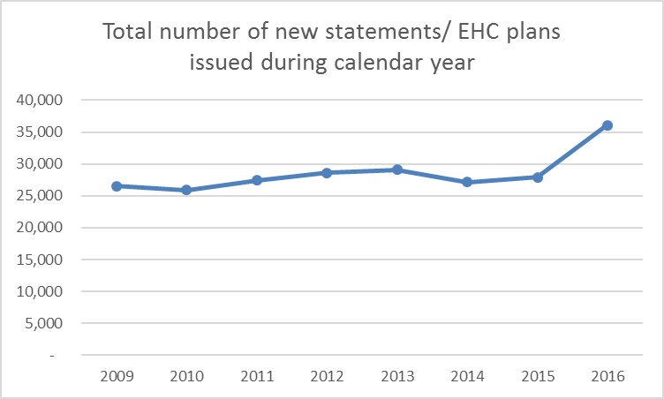
The position as at January 2017
Increased demand for EHC Plans - over 8,000 more plans issued in 2016 compared to 2015
There are now more than 30,000 statements/ EHCPs in the system than last year

Slide 27
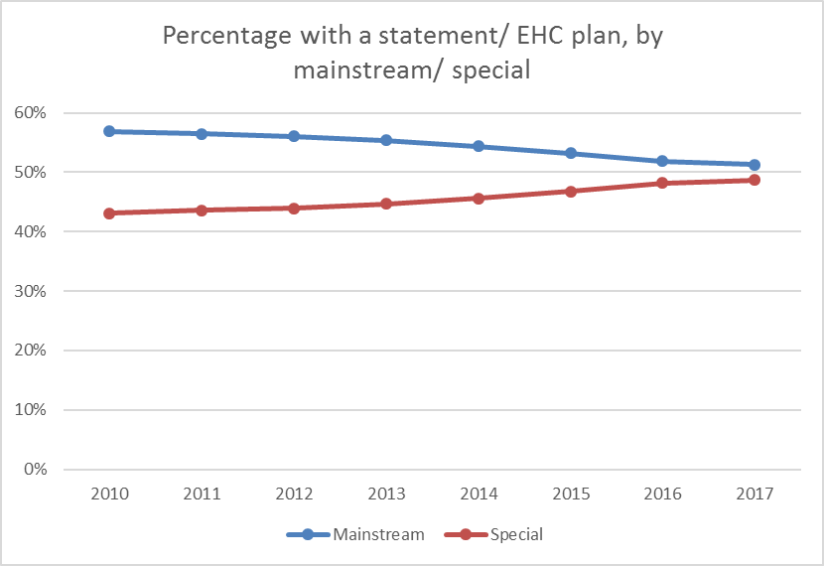
Mainstream/ Special Placements (May 2017)
A small drop in numbers of EHC Plans or statements in mainstream education; an increase in special school places – now roughly 50:50

Slide 28
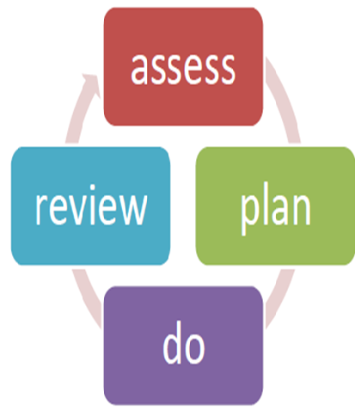
Making SEN Support work - Local authority
LAs must set out the responsibilities for special educational provision made from school, early years and post-16
Clear arrangements for accessing support services, e.g. EPs; CAMHS; specialist teachers/ support services; therapists; special school outreach (where provided)
SENCO and class teacher, with specialists, involving the pupil’s parents - focus on evidence-based effective teaching approaches, equipment, strategies and interventions.
Support systems for SENCOs

Slide 29
Special Schools - Supporting the mainstreaming agenda
Special schools (in the maintained, academy, non-maintained and independent sectors), special post-16 institutions and specialist colleges all have an important role in
(a) providing for children and young people with SEN and
(b) in working collaboratively with mainstream and special settings to develop and share expertise and approaches.
SEND Code of Practice (2015)

Slide 30
Exclusions - Children’s Commissioner, Nov 2017
Tens of thousands of children are educated outside mainstream or special school
Official exclusions are rising; many children also being excluded by the back door through ‘hidden’ or unofficial exclusions
Nine out of ten mainstream schools benefit from these pupils leaving, in that their performance data is improved - effect is strongest for sponsor academies.
Some children, including highly vulnerable ones, are not in education at all.
Home education - a growing number could reflect pressure being asserted by the child’s former school.

Slide 31
Exclusion data 2015-16
Permanent exclusions
0.32% of pupils on SEN support received a permanent exclusion compared to 0.17% of pupils with statements or EHCPs and 0.05% of pupils with no SEN.
Fixed- term exclusions
5.93% of pupils on SEN support received a fixed period exclusion compared to 6.30% of pupils with statements or EHCPs and 1.46% of pupils with no SEN.

Slide 32
Illegal Exclusions
Amanda Spielman (Dec 2017)
“Children with SEN are not a problem to be pushed out of sight and out of mind. Off-rolling is an example of where schools have lost sight of the purpose of education, prioritising accountability and gaming over giving children the support that they deserve.”
NEU (National Education Union) – Survey Nov 2017
One in five teachers are aware of illegal exclusions of students with SEND within their educational setting
Geoff Barton (ASCL, November 2017)
“Off-rolling is unethical, inappropriate and beyond repugnant – the consequences are devastating”.

Slide 33
Exclusions – Local area inspection reports
Cambridgeshire (2017) – Improvements in support for CYP who display challenging behaviour…..local area leaders and school leaders working together…permanent exclusions of CYP with SEND reduced by ¾ in a year
Trafford (2017) - Effective systems in place to avoid the permanent exclusion of CYP with SEN. As a result, the number of such pupils who are permanently excluded is low.
Greenwich (2017) - No permanent exclusions for pupils who have SEND in primary schools. Rates of fixed-term exclusions reducing overall, particularly for pupils without EHC plans.

Slide 34
What does successful implementation of the SEND reforms look like?
2. All parties meet their statutory duties
1. Co-production with children, young people and parents
3. Increased satisfaction with access to local services
4. Accurate and timely identification of SEN and disability
7. More YP go on to post-16 education, training & employment
5. Improved attainment and narrowing of gap for CYP with SEND
6. Strong focus on those at SEN Support

Slide 35
More YP go on to post-16 education, training & employment
Progress
“In 12 of the 30 local areas inspected, inspectors identified a strength in how leaders had secured appropriate education, employment and training post-16.
The proportions of young people who have SEND who are not in education, employment and training were low, particularly for those who had an EHC plan”.
Ofsted and CQC, Local area SEND inspections: one year on, Oct 2017
Challenges
Focus on securing education, employment or training for all
Improved links between special schools and colleges
More supported internships

Slide 36
What does successful implementation of the SEND reforms look like?
2. All parties meet their statutory duties
1. Co-production with children, young people and parents
3. Increased satisfaction with access to local services
8. Improved parental confidence
4. Accurate and timely identification of SEN and disability
7. More YP go on to post-16 education, training & employment
5. Improved attainment and narrowing of gap for CYP with SEND
6. Strong focus on those at SEN Support

Slide 37
Improved parental confidence
Progress
Many parents reported positively about the range and quality of short breaks that were on offer.
In nearly all local area inspections, inspectors found some level of parental dissatisfaction. Even in areas that had implemented the reforms well, parents were not always convinced that their children were receiving the package of provision that they should.
Ofsted and CQC, Local area SEND inspections: one year on, Oct 2017
Challenge
All fully implementing S19 of CFA 2014, and ensuring co-production at strategic and individual level

Slide 38
What does successful implementation of the SEND reforms look like?
2. All parties meet their statutory duties
1. Co-production with children, young people and parents
3. Increased satisfaction with access to local services
8. Improved parental confidence
4. Accurate and timely identification of SEN and disability
7. More YP go on to post-16 education, training & employment
5. Improved attainment and narrowing of gap for CYP with SEND
6. Strong focus on those at SEN Support

Slide 39
Priorities moving forward
Ensuring that SEND covers the ‘14.4%’, not just the ‘2.8%’
Improving quality and outcomes
Funding and value for money
Mainstreaming in a context of increasing diversity of school and FE provision
Acting as a SEND champion
Working with partners:
health and social care partners
parents and young people

